Slide 1
ERD Basics
Dr. Anne Powell
CMIS563

Slide 2
Let’s talk databases
Why do we use them? Why not excel?
Last Name | First Name | Email | Adviser Last Name | AdviserEmail
Andrews | Matthew | Matthew_Andrews@ourcampus.edu | Baker | Linda_Baker@ourcampus.edu
Brisbon | Lisa | Lisa_Brisbon@ourcampus.edu | Valdez | Richard_Valdez@ourcampus.edu
Fischer | Douglas | Douglas_Fischer@ourcampus.edu | Backer | Linda_Baker@ourcampus.edu
Hwang | Terry | Terry_Hwang@ourcampus.edu | Taing | Susan_Tang@ourcampus.edu
Lai | Tzu | Tzu_Lai@ourcampus.edu | Valdez | Richard_Valdez@ourcampus.edu
Marino | Chip | Chip_Marino@ourcampus.edu | Tran | Ken_Tran@ourcampus.edu
Thompson | James | James_Thompson@ourcampus.edu | Taing | Susan_Taing@courcampus.edu

Slide 3
The Entity-Relationship Diagram
Picture of the people, places, objects, things, events, or concepts, their characteristics and relationships, for an organization or business.
Visual representation
Communication tool
Independent of technology
Understandable representation of organization data

Slide 4
Entities
Something of importance to a user that needs to be represented in a database
One theme or topic
Restricted to things that can be represented by a single table

Slide 5
The Components of an E-R Diagram…
Entitites
Something of importance to a user that needs to collect data about
One theme or topic (noun)
Relationship
Association between entities (verbs)
Directional
Employee Works in Department
Employee
Works

Slide 6
Notation
Entities
Relationships
Residence
Hall
Student
Residence
Hall
Student
Lives
in
Residence
Hall
Lives in
Student

Slide 7
Relation
A relation is a two-dimensional table that has specific characteristics.
The table dimensions, like a matrix, consist of rows and columns.

Slide 8
Terminology
Synonyms
Each column contains words that are synonyms
An entity is a table is a file.
An entity instance is a row is a record.
An attribute is a column is a field.
Relation |  | Attribute
Entity | Entity Instance | Attribute
Table | Row | Column
File | Record | Field

Slide 9
Characteristics of a Relation/Entity
Rows contain data about an entity.
Columns contain data about attributes of the entity.
Cells of the table hold a single value.
All entries in a column are of the same kind.
Each column has a unique name.
The order of the columns is unimportant.
The order of the rows is unimportant.
No two rows may be identical.

Slide 10
Sample relation/entity
EmployeeNumber | FirstName | LastName
100 | Mary | Abernathy
101 | Jerry | Cadley
104 | Alex | Copley
107 | Megan | Jackson
And one way this might be shown: EMPLOYEE(EmployeeNumber, FirstName, LastName)

Slide 11
A non-relation example
Cells of the table hold multiple values
EmployeeNumber | Phone | LastName
100 | 335-6421, 454-9744 | Abernathy
101 | 215-7789 | Cadley
104 | 610-9850 | Copley
107 | 299-9090 | Jackson

Slide 12
A non-relational table
No two rows may be identical
EmployeeNumber | Phone | LastName
100 | 335-6421 | Abernathy
101 | 215-7789 | Cadley
104 | 610-9850 | Copley
100 | 335-6421 | Abernathy
107 | 299-9090 | Jackson

Slide 13
And there’s more
Attributes
Properties or characteristics of entities
Actual data items we collect
EmpName
Employee
EmpAddr
EmpJob

Slide 14
An entity …
Should Be:
An object that will have many instances in the database
An object that will be composed of multiple attributes
An object that we are trying to model
Should Not Be:
A user of the database system
An output of the database system (e.g., a report)

Slide 15
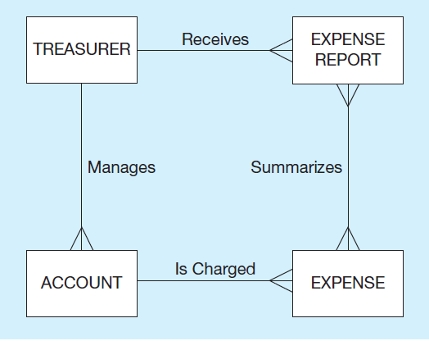

Example of Inappropriate Entities
(a) System user (Treasurer) and output (Expense Report) shown as entities
b) E-R diagram with only the necessary entities

Slide 16
Multivalued Attributes …
… are bad!!!
Attributes that can have multiple values for an entity instance (i.e., a “repeating group”)
Should be re-modeled as a separate entity that has a relationship to the entity type from which it was removed (i.e., a “repeating group” is implemented as a separate table)

Slide 17
Multi-value attributes
EMPLOYEE
PK | EmpID
 | LastName
 | FirstName
 | Children
 | Birthdates
EmpID | LastName | FirstName | Children | Birthdates
6141 | Powell | Anne | Dan, Mike, John | 11/10/2008, 12/07/2012, 04/19/2014
6142 | Hannah | Katie | Ike, Isabelle | 01/28/2009, 01/31/2011
6143 | Thrall | Daniel | Will, Margaret, Edie | 08/06/2009, 02/13/2013, 10/21/2017

Slide 18
